Slide 1
Smart Parking System
Digital Technothon - 29 August 2017
- Group No 6 (Kajal, Onkar and Swaroop)
Notes:
JOE

Slide 2
Content
01
Concept of the project
02
Broad level solution
03
Required hardware and software
04
Building blocks
05
Demo
06
Questions & Answers
Notes:
JOE
Explain how we got here:
Greg Sears visited Persistent Pune in Aug 2016 , where Anita and Girish anchored the meeting . Agilent and Thermo CDS expertise was presented to Greg .
Joe met with Greg to outline this visit in Waltham

Slide 3
Smart Parking System : Concept
Existing Problem
In a large parking area, finding free parking slot is a challenge.
Managing parking slot becomes cumbersome for the managing staff and also visitors find it a laborious task to hunt for a free parking slot.
Proposed Solution
Using IOT based system, we can help end users to find available parking slot easily and thereby reduce the efforts for the visitors and the management team as well.

Slide 4
Broad Level Solution
Figuring out an empty parking slot
When a car will be parked in a parking slot, we will mark the slot as occupied and when it would moves out, we will mark the parking slot as free using IOT technology.
Display screen at the parking entrance
Availability of the parking slots will be displayed at the parking entrance.
Free slots and occupied slots will be displayed with different colors so that the car driver would be able to figure out the free slot to park the car.

Slide 5
Required Hardware and Software
Ultrasonic Sensor
An Ultrasonic sensor is a device that can measure the distance to an object by using sound waves.
It measures distance by sending out a sound wave at a specific frequency and listening for that sound wave to bounce back.
By recording the elapsed time between the sound wave being generated and the sound wave bouncing back, it is possible to calculate the distance between the sonar sensor and the object.
This sensor will help us to identify the presence of vehicle.
For this application, we will put the sensor at the roof of the parking slot and will measure the distance from the top.
When car would be parked, this distance will get reduced and hence we will be able to know that the parking slot is occupied. If the distance will not be reduced, we can say that the parking slot is empty.

Slide 6
Required Hardware and Software (Cont..)
Arduino Uno Board
Ultrasonic sensor will only sense the data but we need to read the data and process it.
For his we will need Arduino board that would help us to mount the sensor and read the data coming from sensors.
Wi-Fi Shield
We will have the sensed data on Arduino board which we need to push to outside world.
Using Wi-Fi shield we will transfer the data over the internet.
Arduino Programming
We will write a program to read the sensor data. Program will be burned on the Arduino Uno microprocessor which will read and process the data.

Slide 7
Required Hardware and Software (Cont..)
Node Red / with IBM Blue Mix
Using Node red application, we will read the data coming from wi-fi shield.
We will add our application logic here to analyze the incoming data and process it.
We will add here a presentation logic to display free and occupied parking slots.
With the help of IBM Bluemix, we will get a web service end point which will showcase live status of the parking slot.
MQTT Protocol
MQTT (Message Queue Telemetry Transport) is a publish-subscribe based “lightweight” messaging protocol designed for connections with remote locations where “a small code footprint” is required or network bandwidth is limited.
The publish-subscribe messaging pattern requires a message broker.
The broker is responsible for distributing messages to interested clients based on the topic of the message.
Here in this application we would be using MQTT protocol to transfer the distance sensed between the sensor and surface of the car.

Slide 8
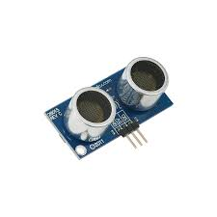
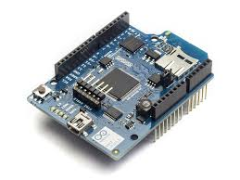
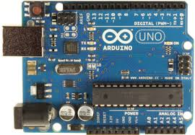
Building blocks
Sensor mounted on Arduino board
NODE RED by IBM BLUEMIX
LIVE status of parking slot
Arduino connected to Wi-Fi shield

Slide 9
Demo

Slide 10
Questions & Answers

Slide 11
Thanks !

